Slide 1
In The Name Of God
Python GUI
Winter 2019
By : Hossein Dehghanipour ( Blue Owl )

Slide 2
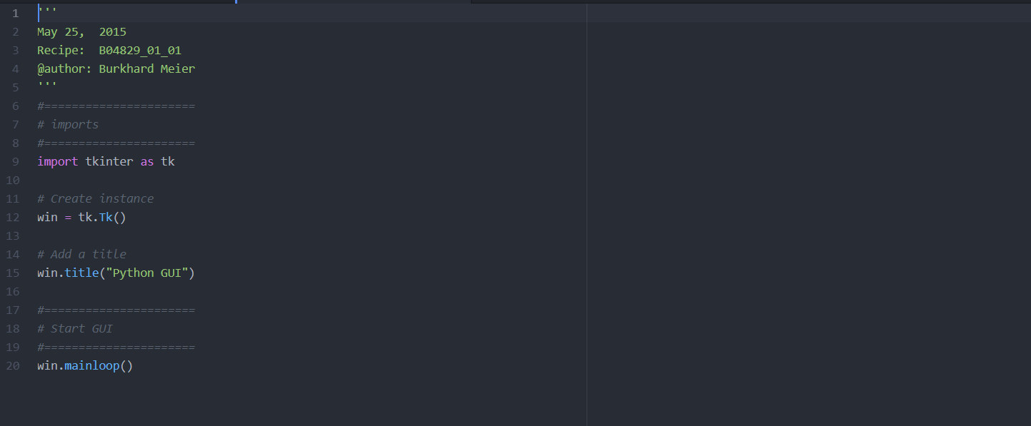
First GUI

Slide 3
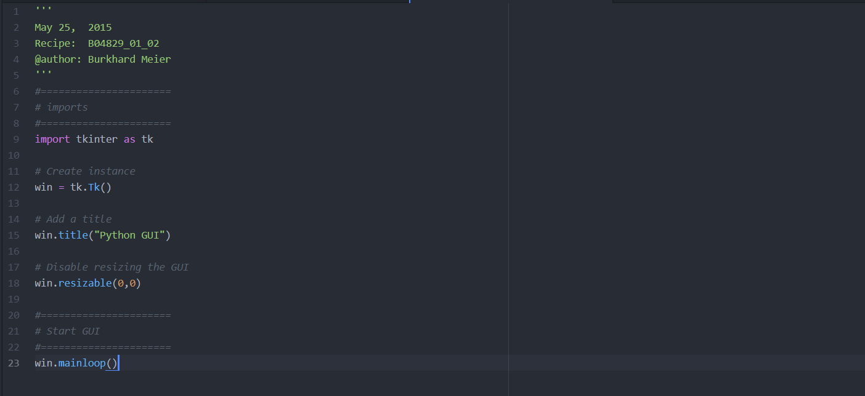
Making The Window Not Resizable

Slide 4
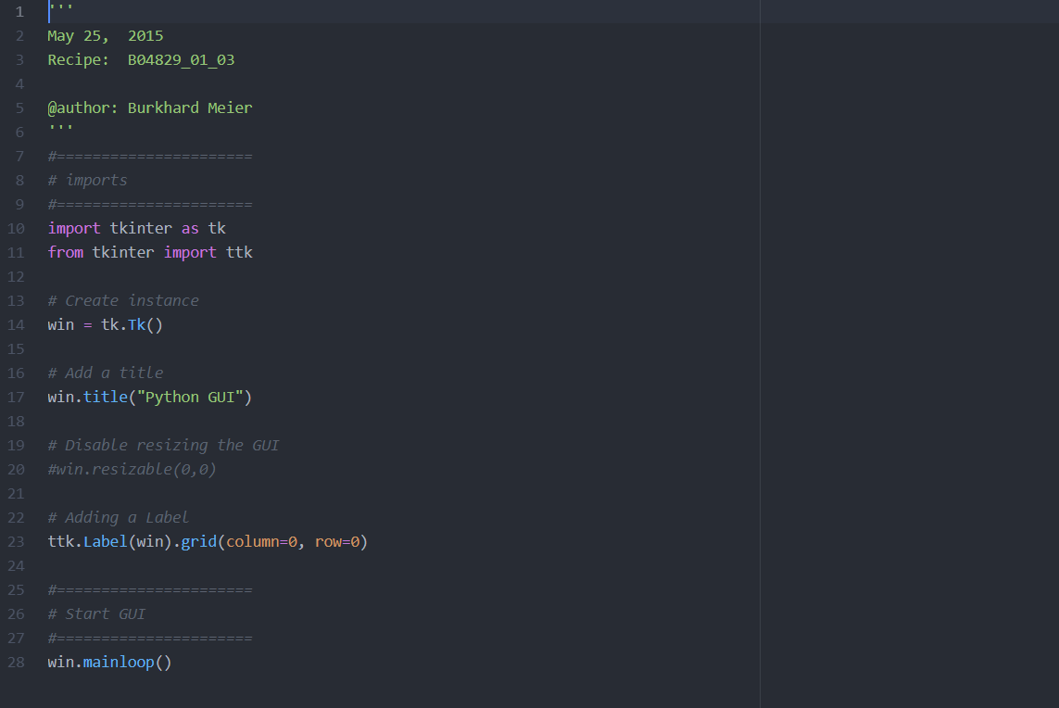
Adding A Label

Slide 5
Adding A Button
# We call this function ( clickMe) a " Call Back " function which means by the time that this function is clicked all the variables used in this function are already known.
# Note that tKinter is not python but we can use it from python. It’s a third party library that’s why we are going to declare it as a stringVar before use.

Slide 6
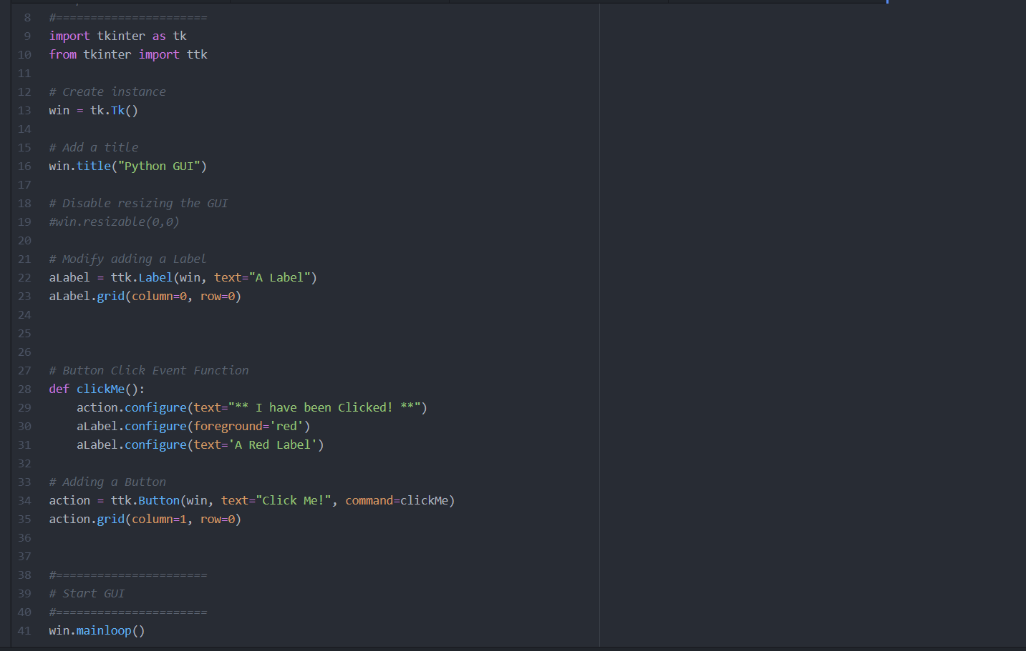

Slide 7
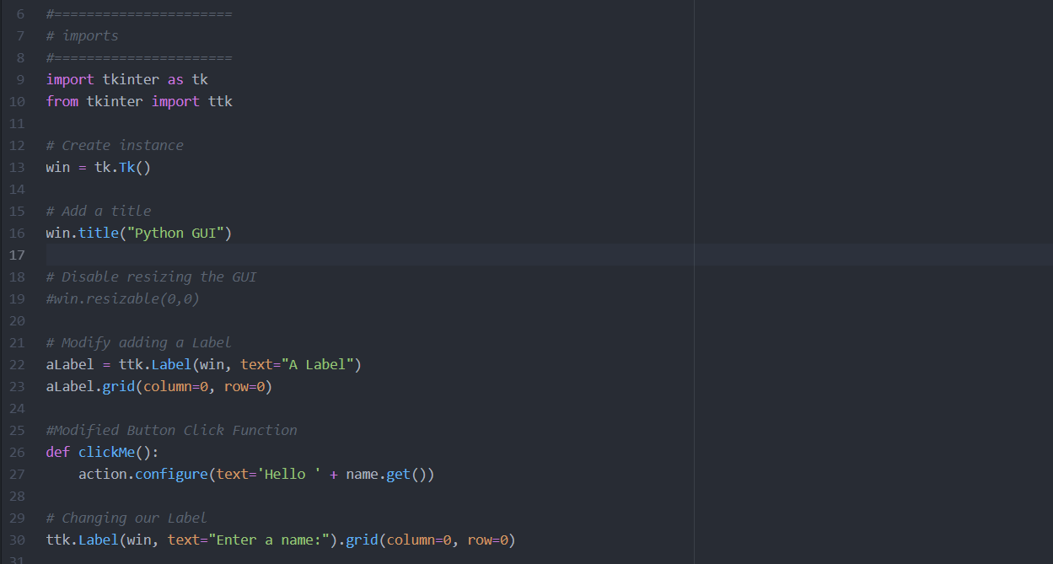
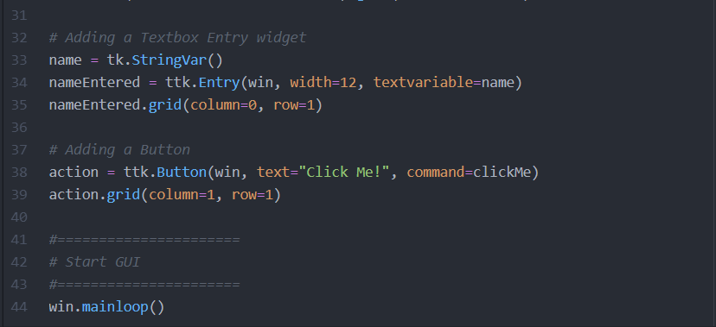
Get an Entry
The Width set on Line 34 limits our button text to 12 characters.

Slide 8
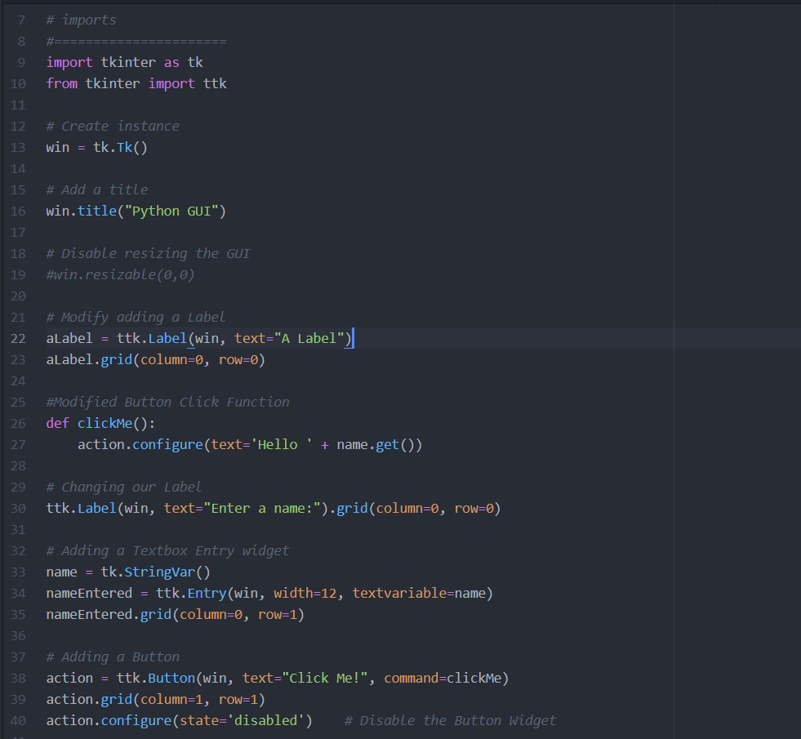
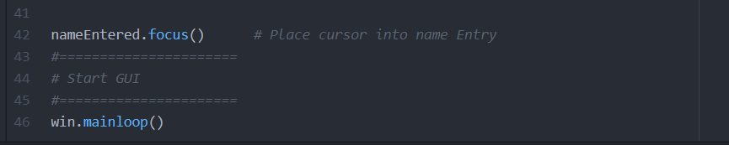
Disable a Button and put the curser at the beginning of the text ( setFocus)

Slide 9
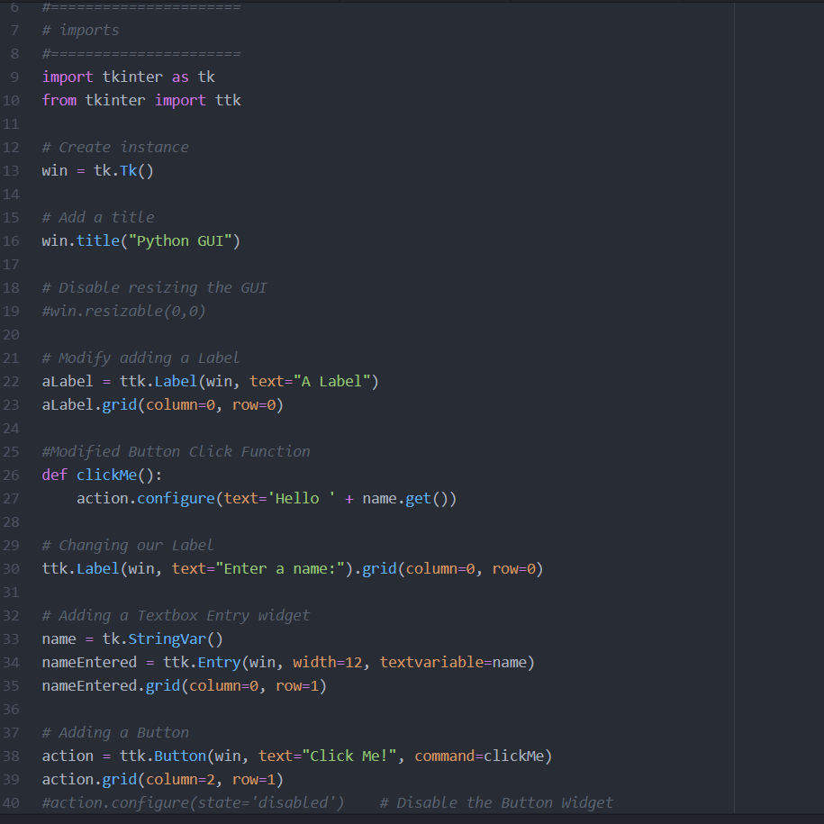
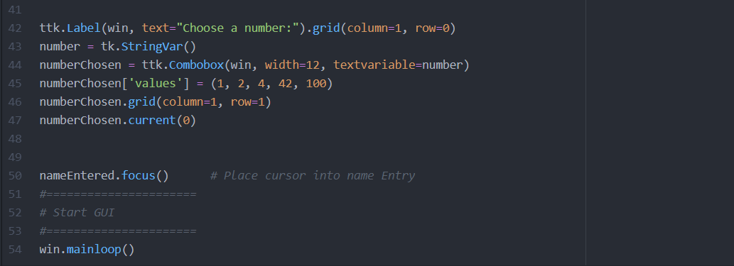
Combo Box
This line determines the default value to be shown at the start-up of the combo-box
if I add numberChosen.get() then I get the number chosen by the user in the combo-box

Slide 10
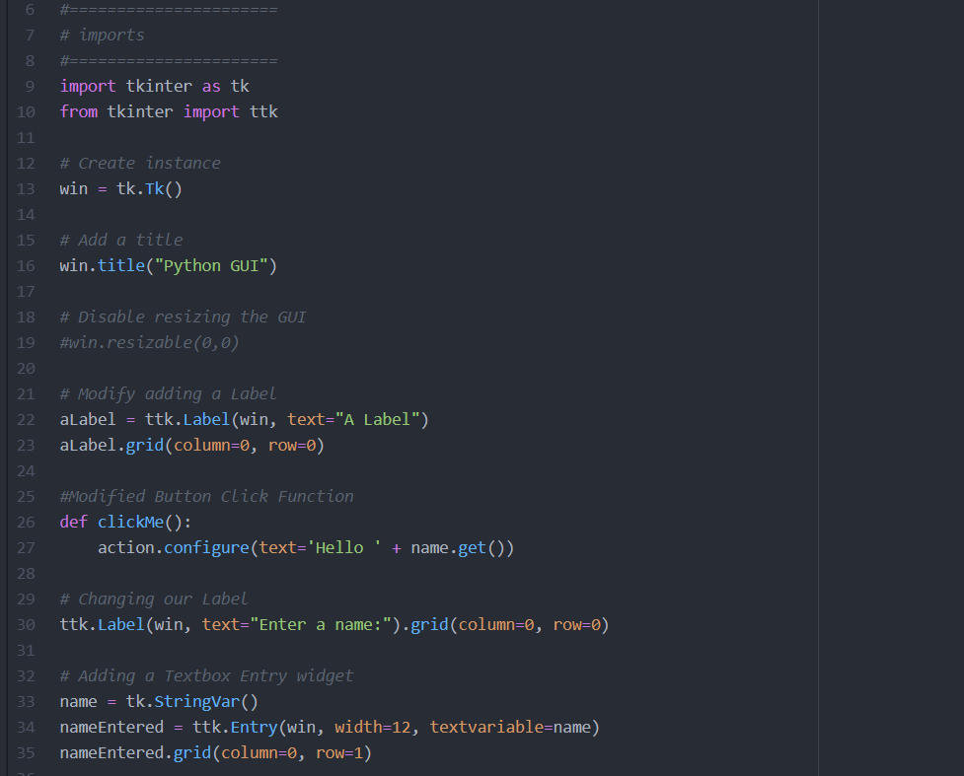
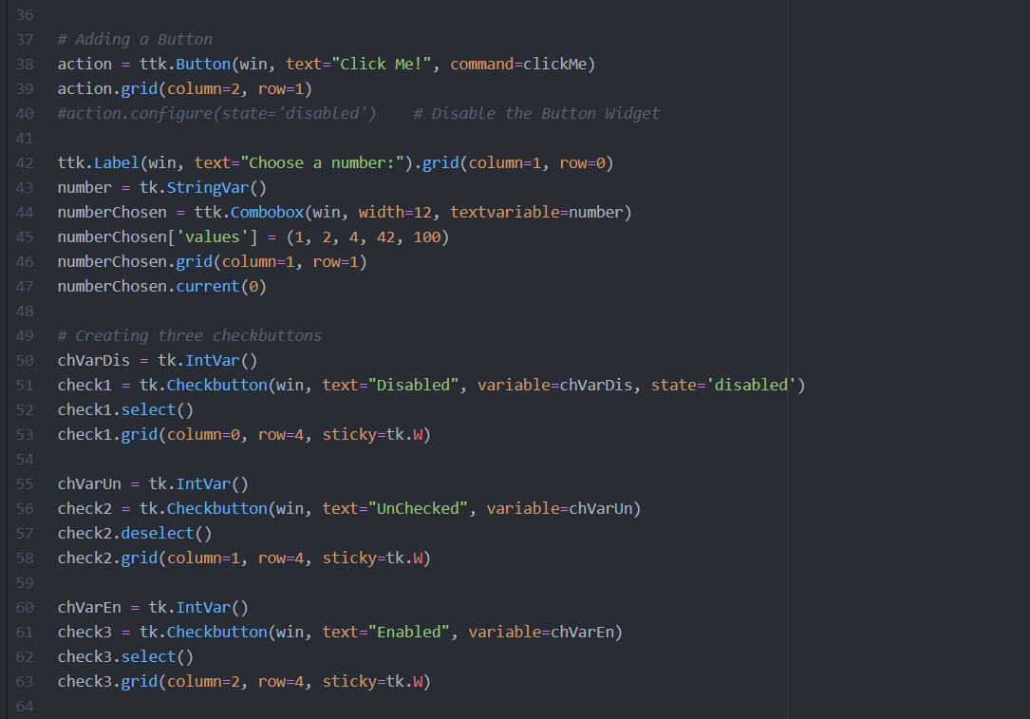
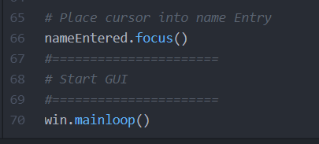
Check Buttons

Slide 11
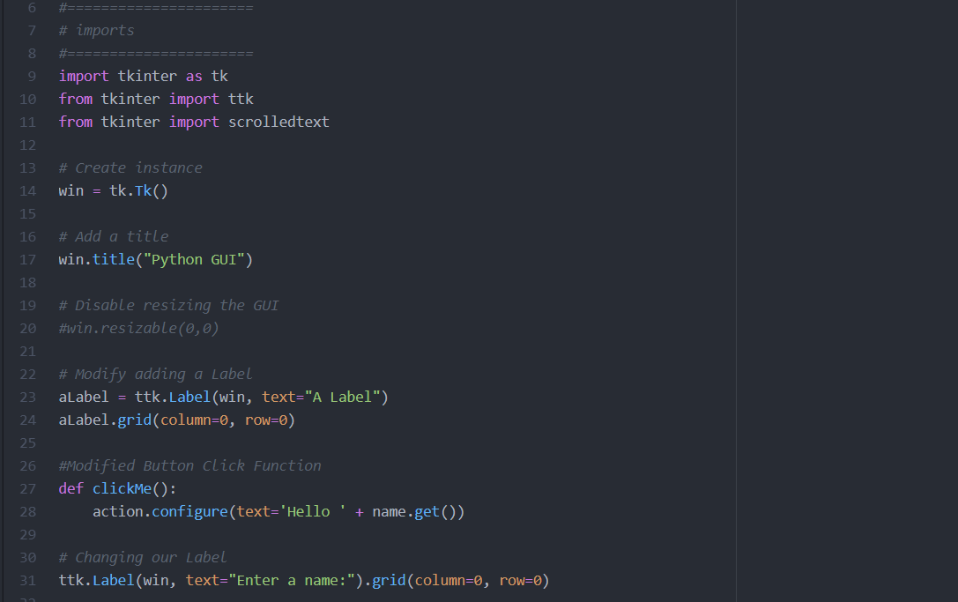
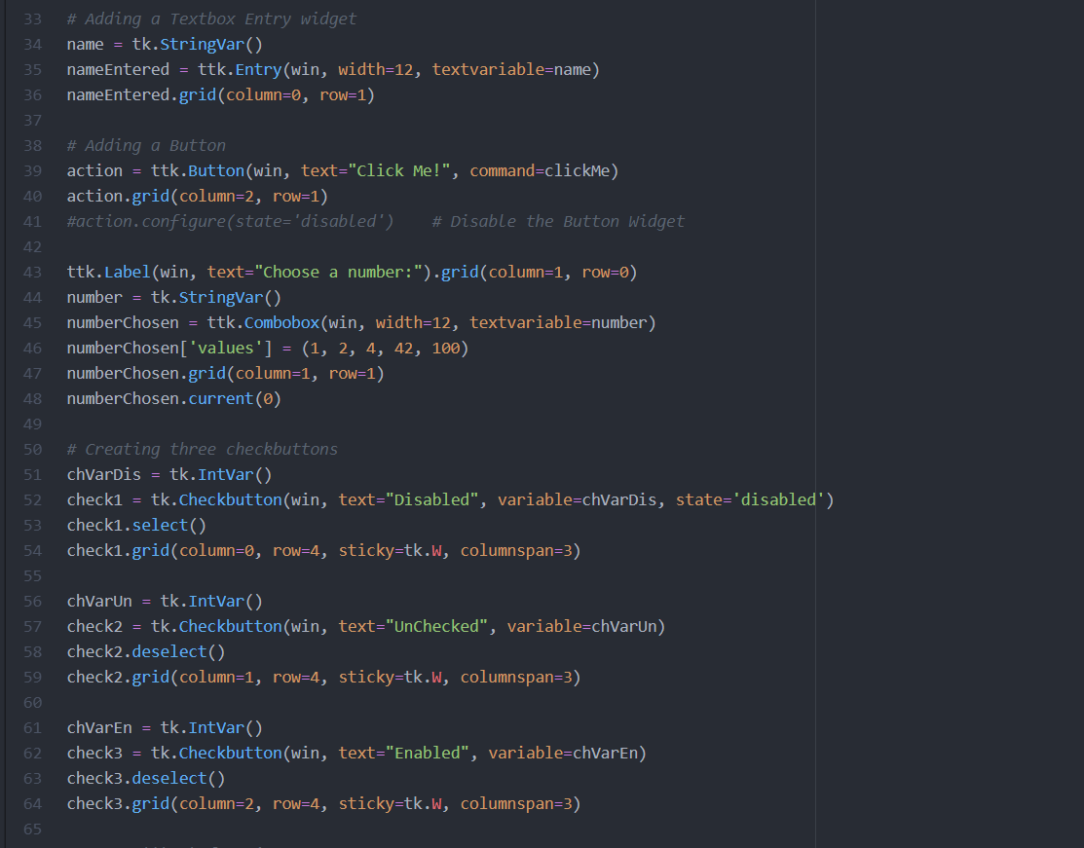
Radio Button

Slide 12
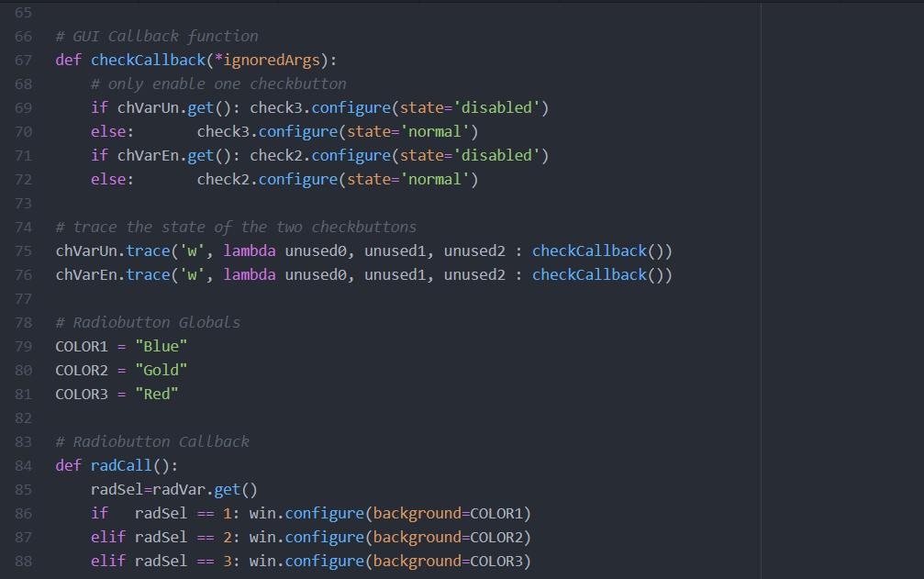
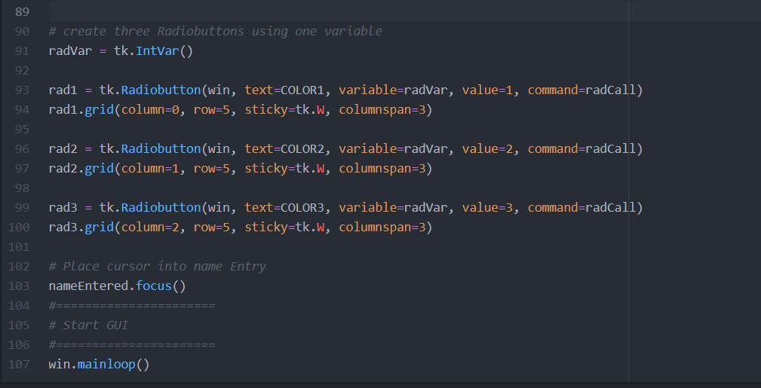

Slide 13
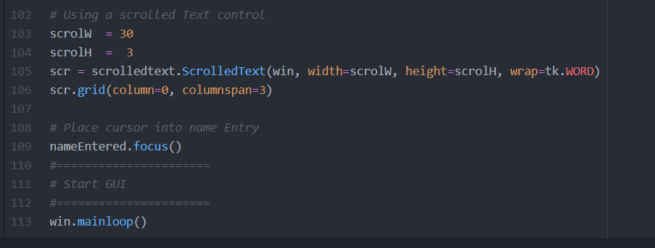
Scroll text Widget
Don’t Forget to import this line of code :
from tkinter import scrolledtext

Slide 14
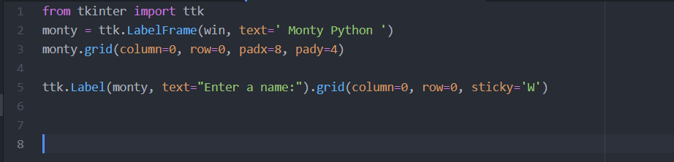
Parent Frame
Our desired parent layer
We add the parent layer as other layer’s parent

Slide 15
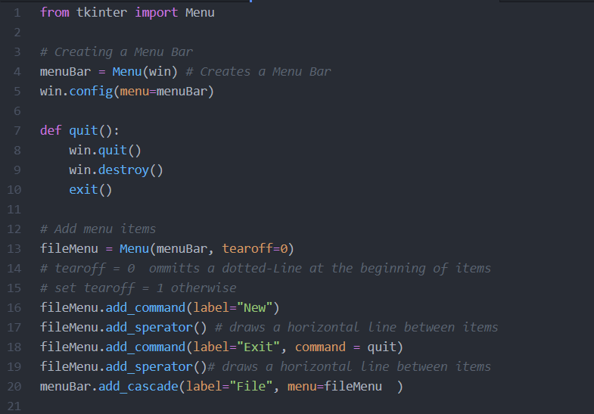
Menu Bar

